Slide 1
THE IMPACTS OF CLIMATE CHANGE ON OCCUPATIONAL HEALTH AND SAFETY
BY
ENGR. DR. RICHARD ANTIGHA, JP.
MNSE, MNISafetyE, MNIAE, MNAHS, R. Eng., COREN.
During The 2024 World Safety Day & Induction,
Today, 28th April, 2024.

Slide 2
DEFINITIONS
Climate change: This is a long-term change in the average weather patterns that have come to define earth’s local, regional and global climates. This was first observed by the Swedish Physicist, Svante Arrhenius in 1896
Occupational Health and Safety: This is a multidisciplinary field concerned with the safety, health, and welfare of people AT WORK (that is, while performing duties required by one's occupation)
Impact: The action of one object coming forcibly into contact with another; A marked effect or influence

Slide 3
STATISTICS
Earth’s temperature has risen by an average of 0.11degree centigrade per decade since 1850 . 1850 – 2024 = roughly 18 decades
= 18 decades x 0.11 = 1.98 degrees (increment in temperature)
From 1982, the rate of warming changed to 0.36. 1982-2024 = 3decades
= 0.36 x3 = 1.08degrees (incremental increment in temperature)
Records show the ten warmest years to be 2014- 2023
2023 increased to 1.18 degree centigrade
2024 has rubbished them all (with exponential increment in temperature)

Slide 4
STAT. CONTD
By 2030, up to 3.8% of the total working hours could be lost because of climate induced high temperatures.
Poor air quality, disease-carrying pests, flooding and wildfires will also impact workers and lead to job losses.

Slide 5
IMPACTS
Not fewer than 1.6 billion workers are exposed to UV radiation
More than 18,960 work-related deaths annually arising from nonmeloma
No fewer than 1.6 billion exposed to workplace air pollution resulting in not fewer than 860,000 work-related deaths among outdoor workers annually
Respiratory and heart diseases, pest-related diseases like Lyme diseases and West Nile Virus, Water-and – Food related illnesses, and injuries and deaths

Slide 6
IMPACTS CONTD
As climate change intensifies, workers around the globe find themselves at an increased risk of exposure to hazards such as excessive heat, ultraviolet radiation, extreme weather events, air pollution, vector-borne diseases and agrochemicals
More humidity and moisture can lead to increase in mould, bacteria, and pest, which can worsen asthma and other respiratory effects for indoor workers in damp environment.
Certain workers may be part of other groups vulnerable to climate change. This can increase their health risks.

Slide 7
SAFETY CONCERNS OF CLIMATE CHANGE
Increased ambient temperatures
Air pollution
Ozone depletion leading to increased ultraviolet radiation
Extreme weathers. These impact on safe drinking water because as the climate changes.
Increase in mental health effects
Sea levels are rising and the oceans are becoming warmer
Rivers Eutrophication

Slide 8
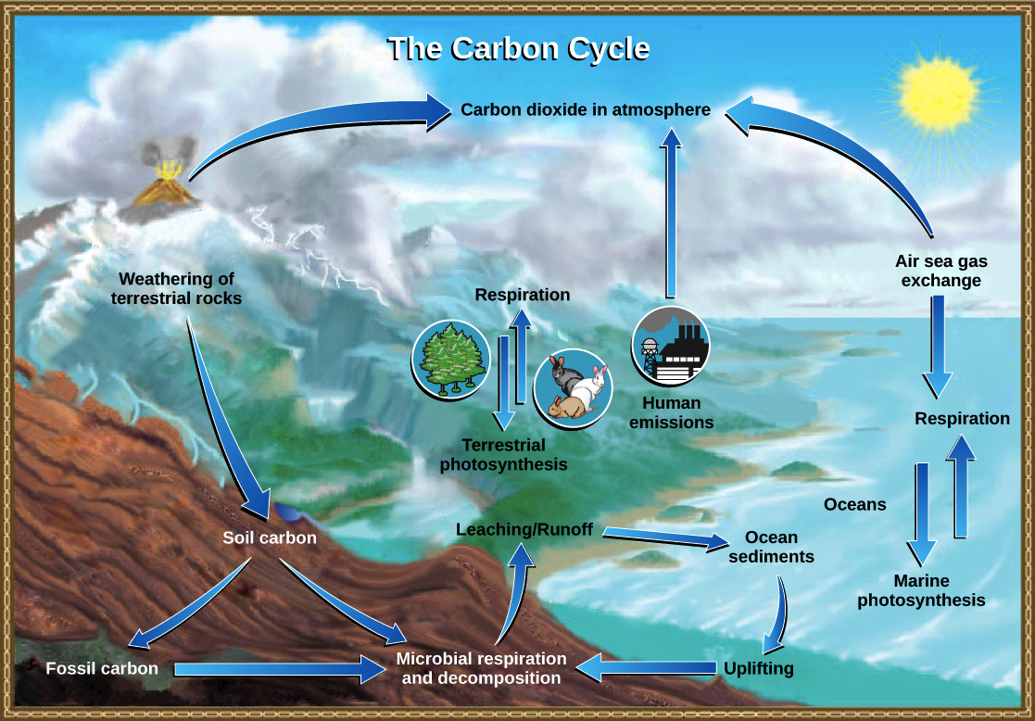
The Carbon Cycle- The Cradle of Climate Change

Slide 9
HOW CARBON ENTERS THE ATMOSPHERE
The carbonate—CO3²⁻ released in this process combines with Ca²⁺ {Ca}^{2+}Ca²⁺ ions to make calcium carbonate—CaCO3 a key component of the shells of marine organisms. When the organisms die, their remains may sink and eventually become part of the sediment on the ocean floor. Over geologic time, the sediment turns into limestone, which is the largest carbon reservoir on Earth.
On land, carbon is stored in soil as organic carbon from the decomposition of living organisms or as inorganic carbon from weathering of terrestrial rock and minerals. Deeper under the ground are fossil fuels such as oil, coal, and natural gas, which are the remains of plants decomposed under anaerobic—oxygen-free—conditions. Fossil fuels take millions of years to form. When humans burn them, carbon is released into the atmosphere as carbon (iv) oxide.
Another way for carbon to enter the atmosphere is by the eruption of volcanoes. Carbon-containing sediments in the ocean floor are taken deep within the Earth in a process called subduction, in which one tectonic plate moves under another. This process forms carbon (iv) oxide, which can be released into the atmosphere by volcanic eruptions or hydrothermal vents.

Slide 10
Human impacts on the carbon cycle
Global demand for Earth’s limited fossil fuel reserves has risen since the beginning of the Industrial Revolution. Fossil fuels are considered a non-renewable resource because they are being used up much faster than they can be produced by geological processes.
When fossil fuels are burned, carbon (iv) oxide—CO₂—is released into the air. Increasing use of fossil fuels has led to elevated levels of atmospheric CO₂. Deforestation—the cutting-down of forests—is also a major contributor to increasing CO₂ levels. Trees and other parts of a forest ecosystem sequester carbon, and much of the carbon is released as CO₂ if the forest is cleared.
Some of the extra CO₂ produced by human activities is taken up by plants or absorbed by the ocean, but these processes don't fully counteract the increase. So, atmospheric CO₂ levels have risen and continue to rise. CO₂ levels naturally rise and fall in cycles over long periods of time, but they are higher now than they have been in the past 400,000 years.

Slide 11
OZONE DEPLETION AND GLOBAL WARMING
The key difference between ozone depletion and global warming is that ozone depletion is the decrease in the thickness of the ozone layer, whereas global warming is the increase of heat in the atmosphere

Slide 12
CONTD
The heat caused by infrared radiation is absorbed by greenhouse gases such as water vapor, carbon dioxide, ozone, and methane, which slows its escape from the atmosphere.
Although greenhouse gases make up only about 1 percent of the Earth's atmosphere, they regulate our climate by trapping heat and holding it in a kind of warm-air blanket that surrounds the planet.
This phenomenon is termed the greenhouse effect

Slide 13
CAUSES OF GLOBAL WARMING
Power Plants
Agriculture
Vehicles and Transport
Landfills
Offshore Drilling
Fracking
Deforestation
Overfishing
Melting Permafrost
Consumerism

Slide 14
TO DO LIST
Actions for healthy planet
Save energy at home – reduce the use of oil, coal and gas as energy sources.
End fossils fuels dependence
Change your home’s source of energy (if you can) - renewable energy-solar, wind, biogas etc
Think IT- Think electric cars and other sustainable transport systems
Reduce, Refuse, Reuse, Repair, Recycle
Grow Green Areas (Sequesters)
Avoid packaged products
Do not promote GMOs
Drive less, Walk more

Slide 15
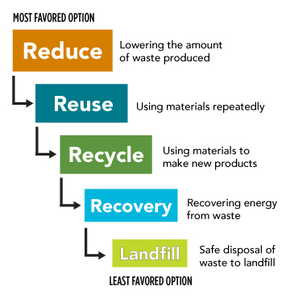
CONTD

Slide 16
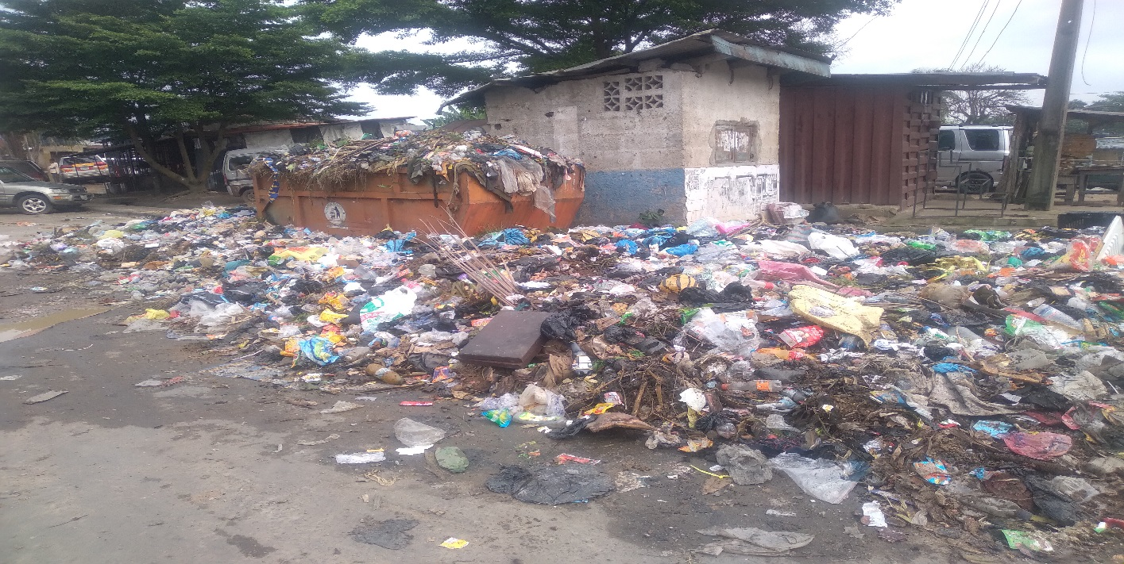
CONTD

Slide 17
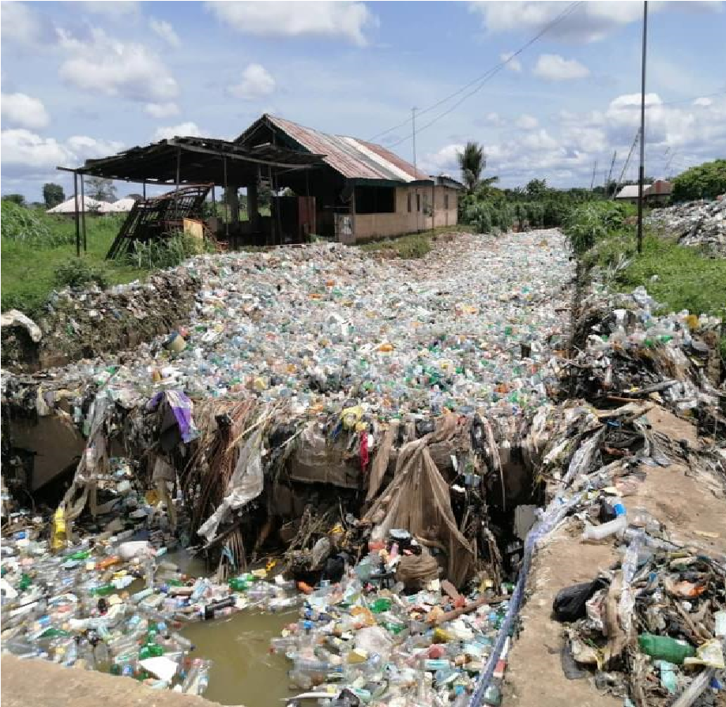
CONTD

Slide 18
CONCLUSION
NISafetyE, The Bedrock of Engineering.
Think Safety, Practice Safety, Live Safety
THANK YOU FOR YOUR TIME.
GOD BLESS YOU

